Slide 1
Optimized Traffic Light Control
Team members: Rodrigo Esteves, Emmanuel Pimentel, Aryan Singh, Song Thao

Slide 2
Introduction
Team Introduction
Aryan Singh and Edgar Kenner
Objectives
To Create and simulate an optimized Traffic light
To include combinational and sequential circuits
Control traffic lights
Optimize flow of traffic to reduce wait time for cars
Account for all cases of lights on the intersection
Add a delay function to switch between traffic lights

Slide 3
Problem Statement
To design a device which would help assist :
Smooth slow of traffic through the intersection
Reduce wait time for the cars by giving priority to waiting cars
Simulate a real life traffic signal
Opportunity solution:
Optimized traffic light Control system
Implement case statements to account for every possible situation on the intersection
Add additional features such as a delay to switch between lights and enable signal to give priority to waiting vehicles.

Slide 4
Background
Working of a 4 way Intersection
Verilog and its use in implementing the traffic light controls
Synthesis of the code
Testing and debugging for errors

Slide 5
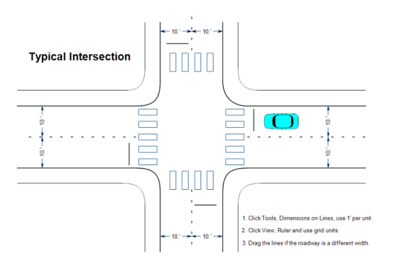
Working of the Intersection
For a four way intersection, the traffic lights use a 555 timer Integrated chip and a CD4017 IC counter.
Every intersection has a width of 20 feet per lane.
Speed limit of 50 miles per hour was assumed
and the calculations were made accordingly.

Slide 6
Verilog Implementation
Verilog is a HDL language used to program hardware.
It is also a RTL language so we can perform micro operations between registers.
In the project it was used to program the traffic light functions along with the delays between each light.
Control of the green, yellow, and red lights was controlled using Verilog too by giving priority to certain lights using the enable function.

Slide 7
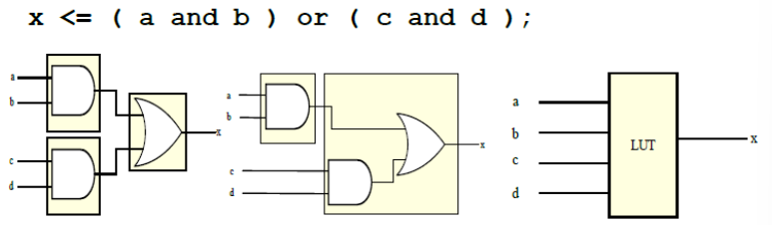
Synthesis
Synthesis is the process of converting a HDL code so that it can be interpreted and implemented into gates and flip flops.
These gates are known as Gate Netlist.

Slide 8
Testing And debugging
Testing is the process of finding errors in the verilog coding.
Debugging is the process of correcting those bugs or errors that were found during the testing process.
In Verilog, we performed debugging by going back every function of the code step by step till we found the origin of the error and debugged it from there.

Slide 9
Design

Slide 10
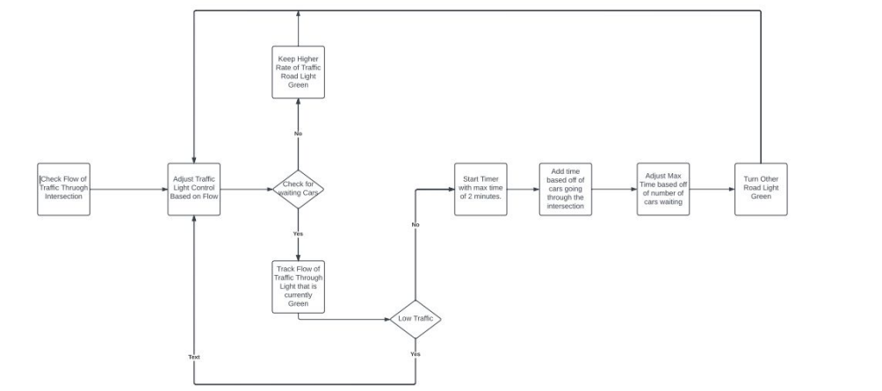
Flow Chart

Slide 11
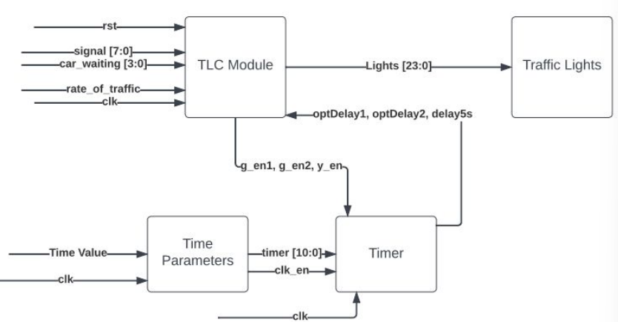
Block Diagram

Slide 12
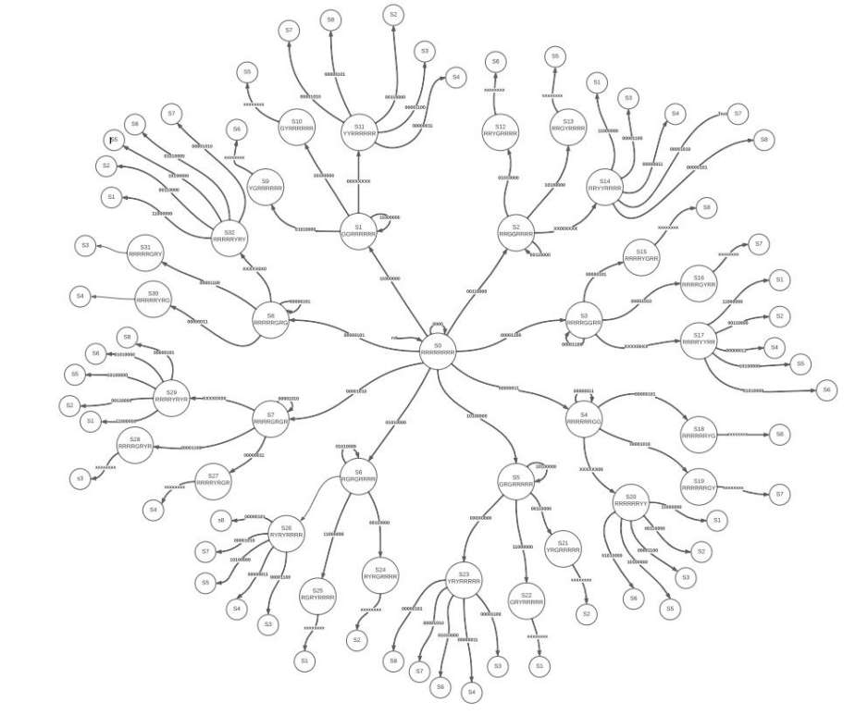
State Diagram

Slide 13
Implementation

Slide 14
Coding
State diagram implementation in TLC module using the case statements for each state change from state 1 through 32.
Timer module to work as the delay.
Optimum wait time to ensure smooth flow of traffic.
Enable signal to apply appropriate delay to each light.

Slide 15
Testing and Debugging
Testbench was used to implement the code and check for its functionality.
Multiple inputs with changed conditions were used to check for each case of the state change.

Slide 16
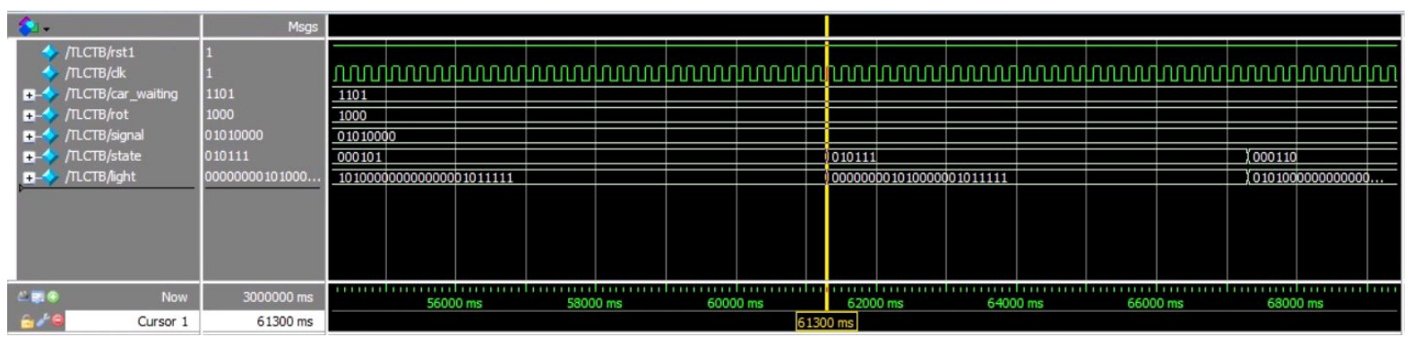
Results

Slide 17
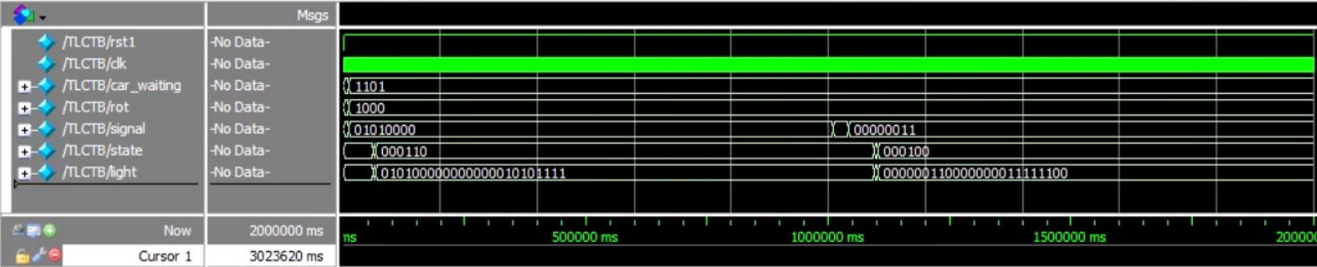
Results (continued)

Slide 18
Conclusion
Implementation of delays, cases and other coding techniques.
Understanding of the real world application of traffic lights.
The link between software and hardware part of engineering was also learned throughout the class.

Slide 19
References
[1] Rff.com. 2022. A Typical Traffic Intersection. [online] Available at: [Accessed 18 May 2022].
[2] Vlsi-project.blogspot.com. 2022. Synthesis Issues. [online] Available at: [Accessed 18 May 2022].

